Slide 1

Designing of IoT Solutions
Introduction
Charanraj B R
Department of Computer Science Engineering

Slide 2

Designing of Iot solutions
Introduction
Charanraj B R
Department of Computer Science Engineering

Slide 3
Designing of IoT Solution
Outline of Presentation
Logical design of IoT

Slide 4
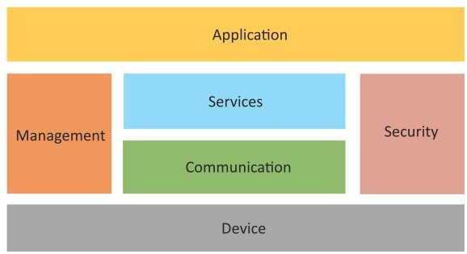
Designing of IoT Solution
Logical Design of IoT
The functional blocks are
Device
communication
Services
Management
Security
Application

Slide 5
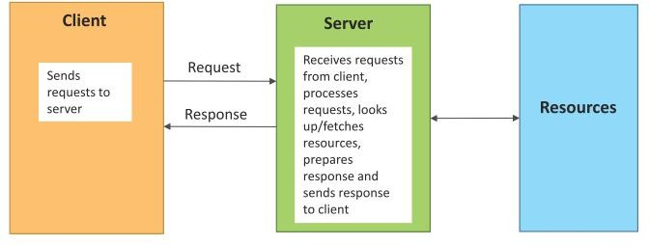
Designing of IoT Solution
IoT Communication Model
Request-Response communication model

Slide 6
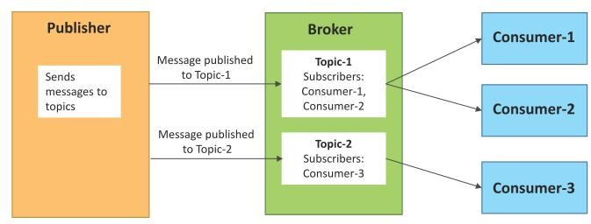
Designing of IoT Solution
IoT Communication Model
Publish-Subscribe communication model

Slide 7
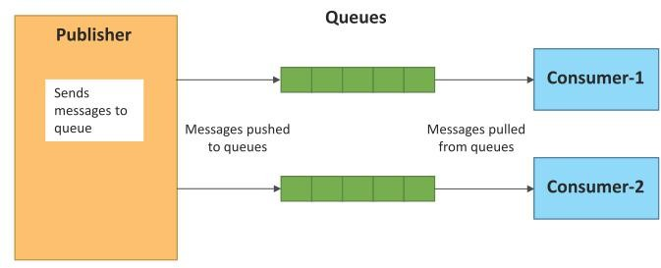
Designing of IoT Solution
IoT Communication Model
Push-Pull communication model

Slide 8
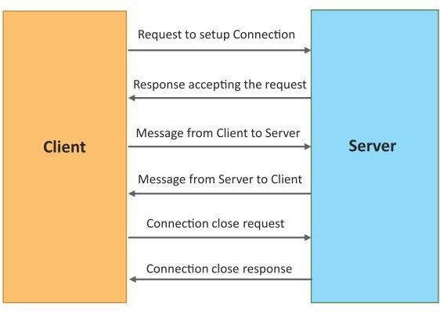
Designing of IoT Solution
IoT Communication Model
Exclusive Pair communication model

Slide 9
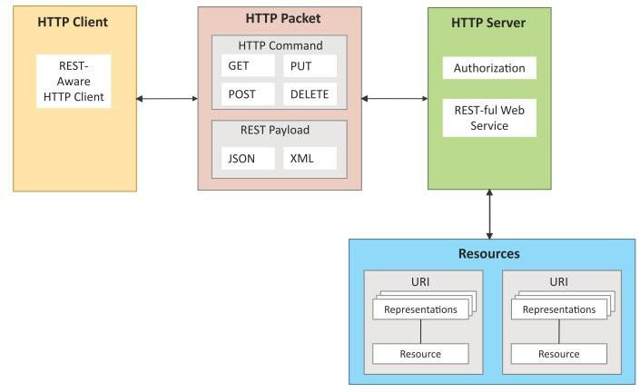
Designing of IoT Solution
IoT Communication APIs
REST-based Communication APIs
Client – server
Stateless
Cache – able
Layered System
Uniform interface
Code on demand

Slide 10
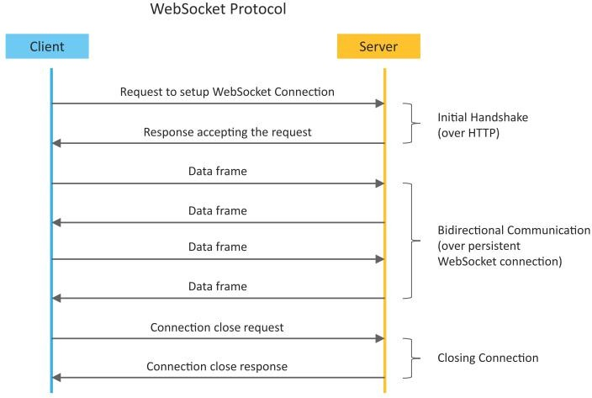
Designing of IoT Solution
IoT Communication APIs
WebSocket-based Communication APIs

Slide 11
THANK YOU
Charanraj B R
Department of Computer Science Engineering
charanarajbr@pes.edu
+91 80 6666 3333 Extn 721

